Slide 1
Sports Encyclopedia
Aarush Lolla

Slide 2
Sports that will be Included!
Soccer
Basketball
American Football
Tennis
Badminton
Cricket
Field Hockey
Golf

Slide 3
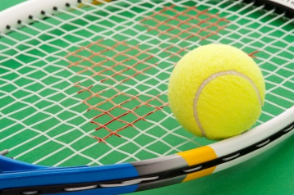
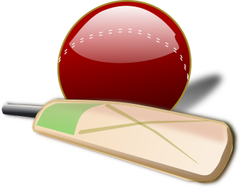
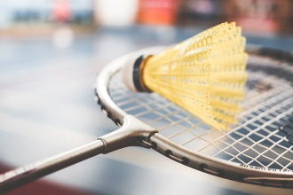
Tennis
Cricket
Badminton
Tennis:
Rules –
Equipment -
Famous Players-
Cricket:
Rules –
Equipment-
Famous Players –
More Images -
Badminton:
Rules –
Equipment-
Famous Players –
More Images -

Slide 4
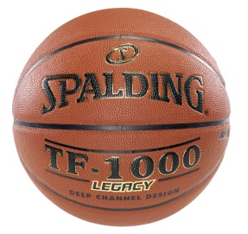
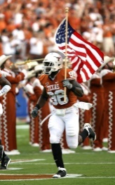

Soccer
Basketball
American Football
Soccer:
Rules –
Equipment -
Famous Players-
Basketball:
Rules –
Equipment-
Famous Players –
More Images -
American Football:
Rules –
Equipment-
Famous Players –
More Images -

Slide 5
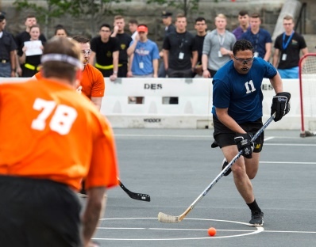
Field Hockey
Golf
Field Hockey:
Rules –
Equipment -
Famous Players-
Golf:
Rules –
Equipment-
Famous Players –
More Images -

Slide 6
Conclusion
End of Wireframe!

